Slide 1
Amazon
Divya ch
Single Point Solutions
Associate Software Engineer

Slide 2
Objectives
Manual Testing Automation Testing CICD Mobile Testing
Test Plan Login Functionalities Git Android SDK
Test Case Page Object Model GitHub Android Studio
Test Case Review Data Driven Testing Jenkins Appium
Defect report Allure Reports Vysor
HTML reports ABD & APK

Slide 3
Setups
Selenium Python 4.26.1
Pycharm 2024.3
Pytest 8.3.4
NodeJS 10.9.0
Allure Reports
Unittest
Jenkins
GitHub

Slide 4
Manual Testing
Manual testing is a software testing approach where testers manually evaluate software or application quality without the help of automated testing tools or test scripts. Testers interact with the system like how an end user would identify bugs, defects, and issues in the software that create friction in user experience.
Test deliverables
1. Test Plan
2. Test Case
3. Defect Report

Slide 5
Features
Sign In
Search
Editing Profile details
Order Details
Payment Details
Sign out

Slide 6
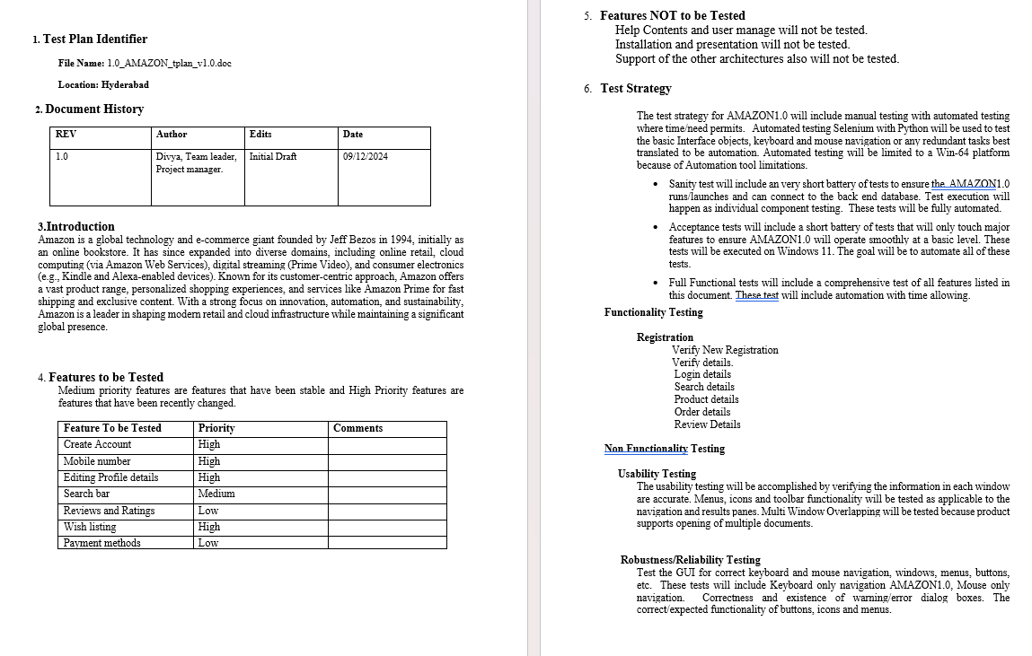
Test Plan Document

Slide 7
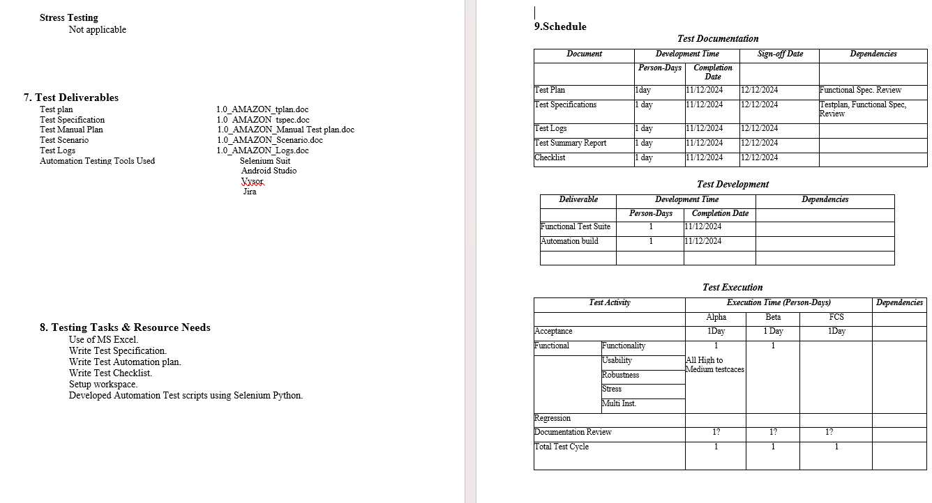

Slide 8
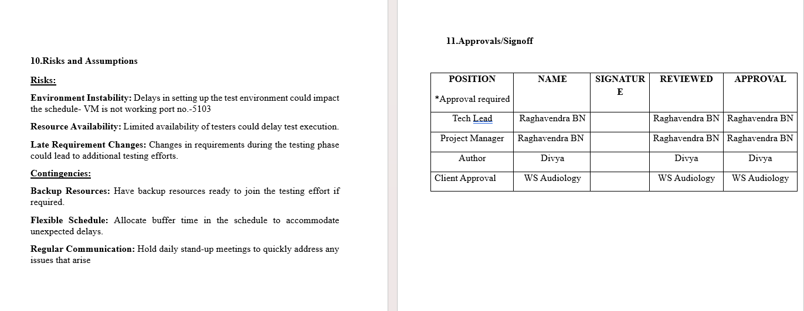

Slide 9
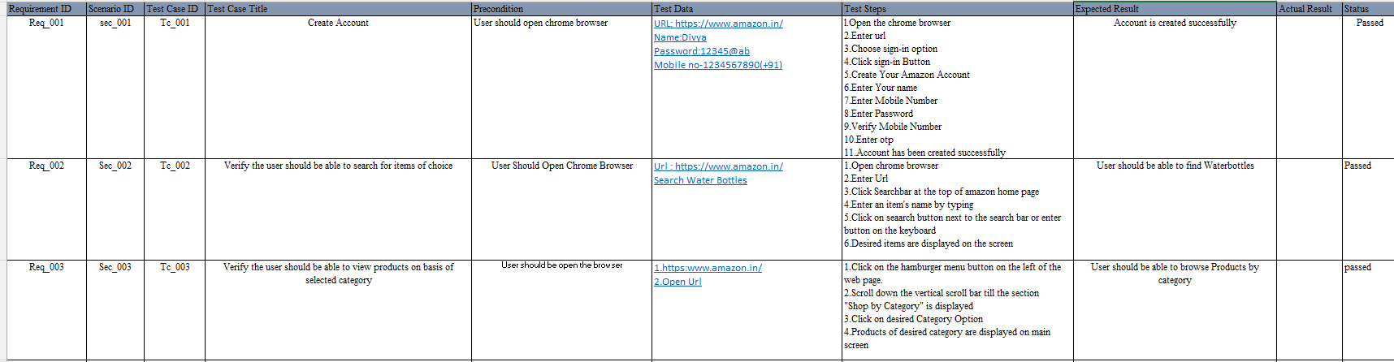
TEST CASE DOCUMENT

Slide 10
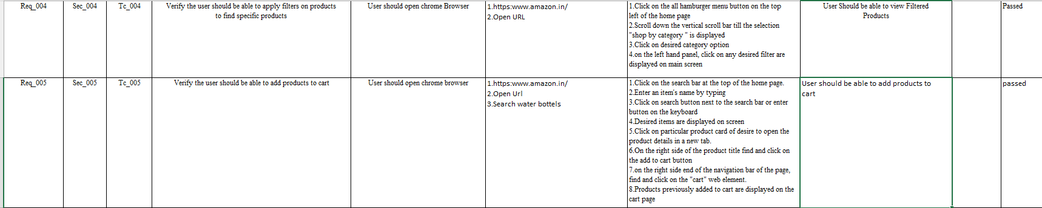

Slide 11
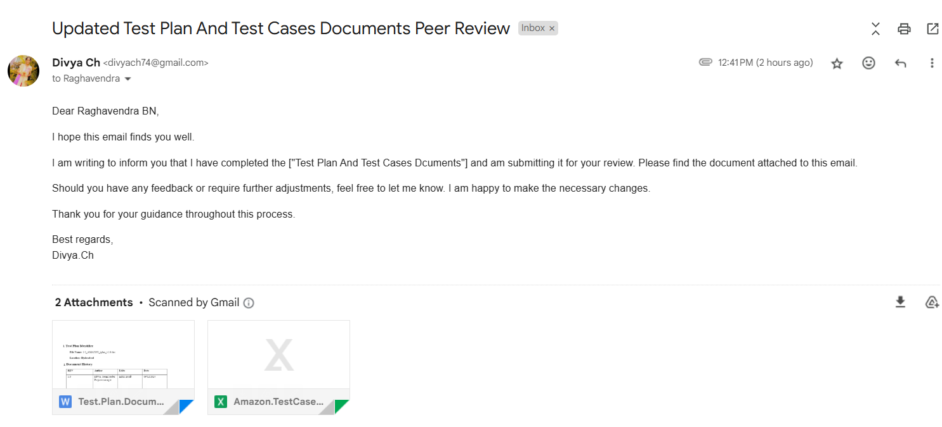
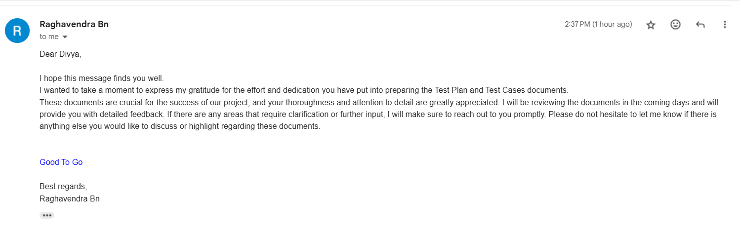
TEST CASE PEER REVIEW

Slide 12
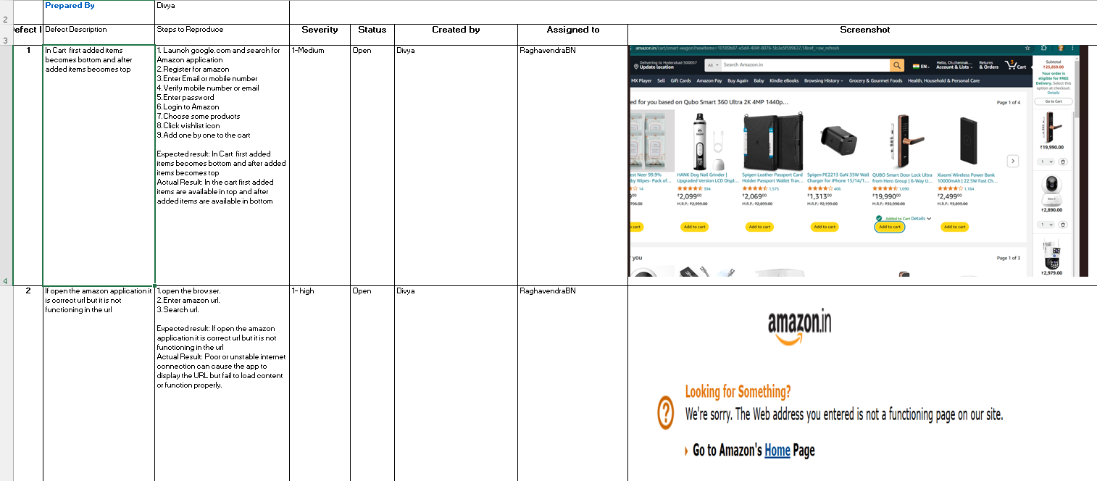
DEFECT REPORT

Slide 13
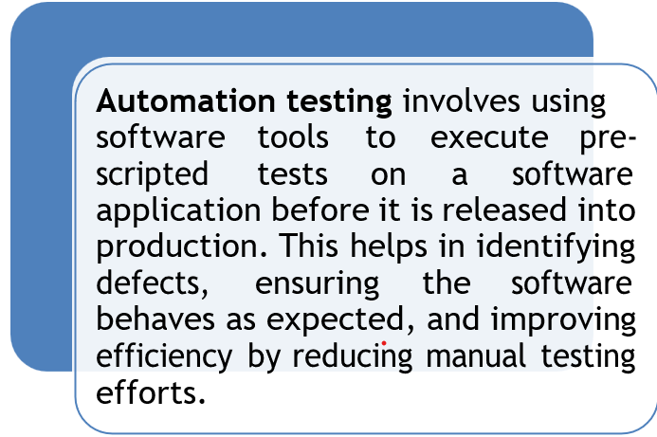
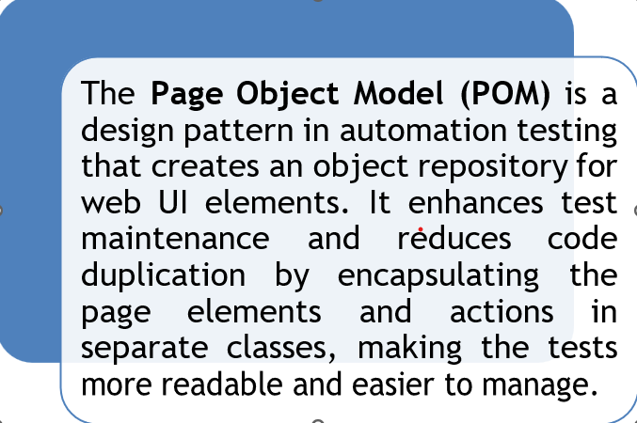
Automation testing
Page Object Model

Slide 14
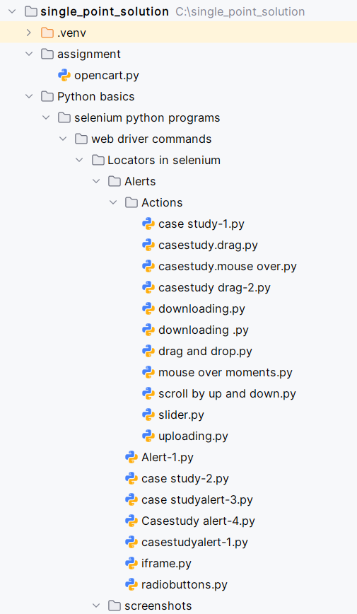
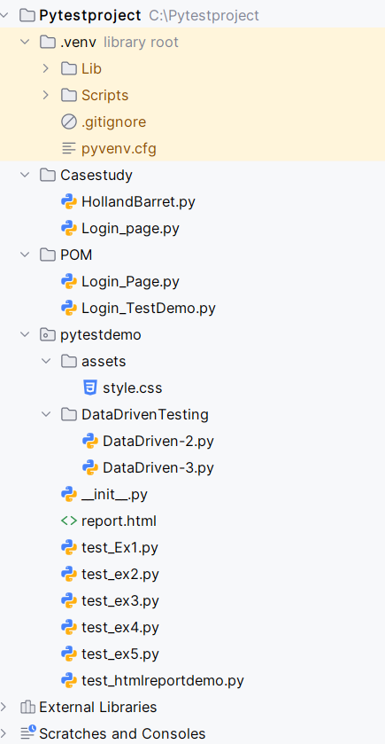
Folder Structure

Slide 15
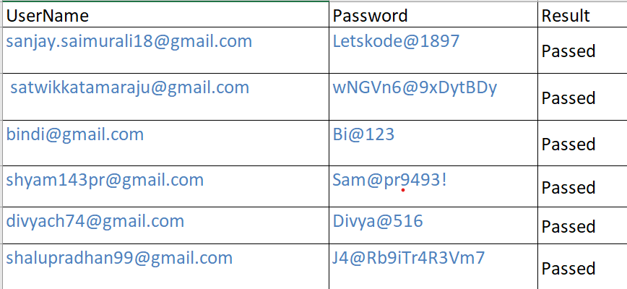
Excel sheet Data

Slide 16
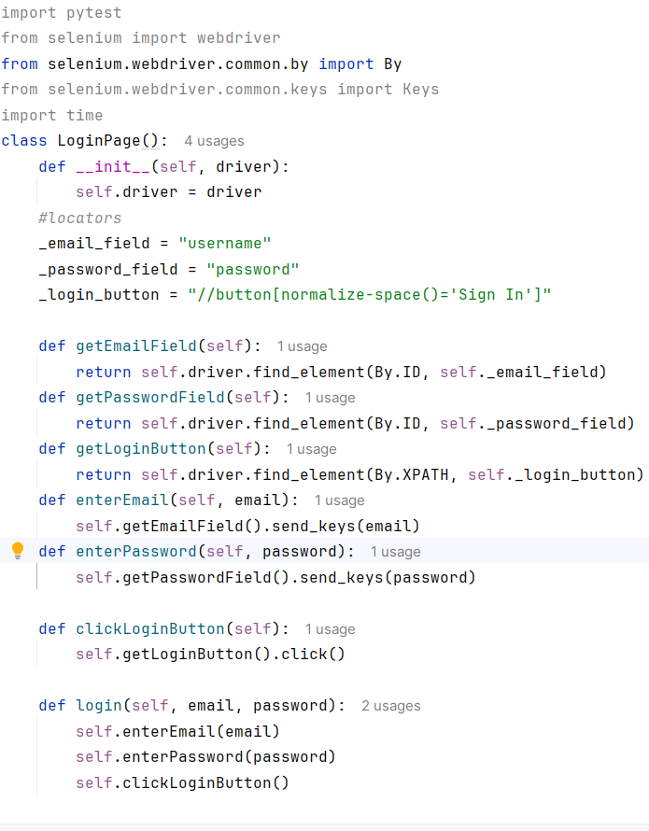
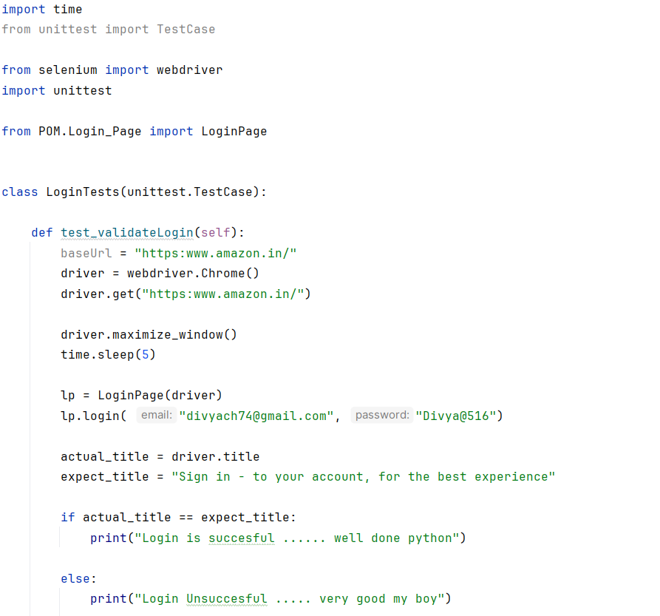
POM FILE.PYTHON

Slide 17
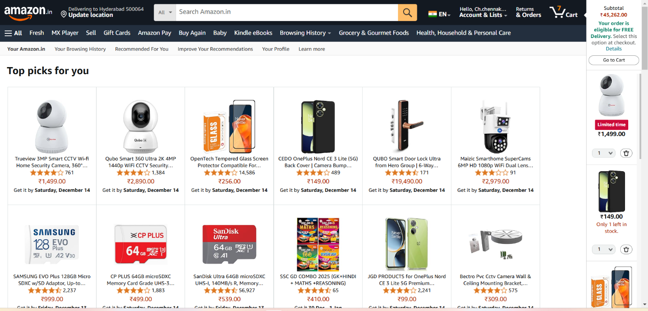
Screenshot

Slide 18
Mobile testing
Mobile testing ensures that apps function correctly on various mobile devices, validating performance, usability, and compatibility. Mobile testing using Appium with the Android SDK allows for automated UI testing of Android applications.

Slide 19
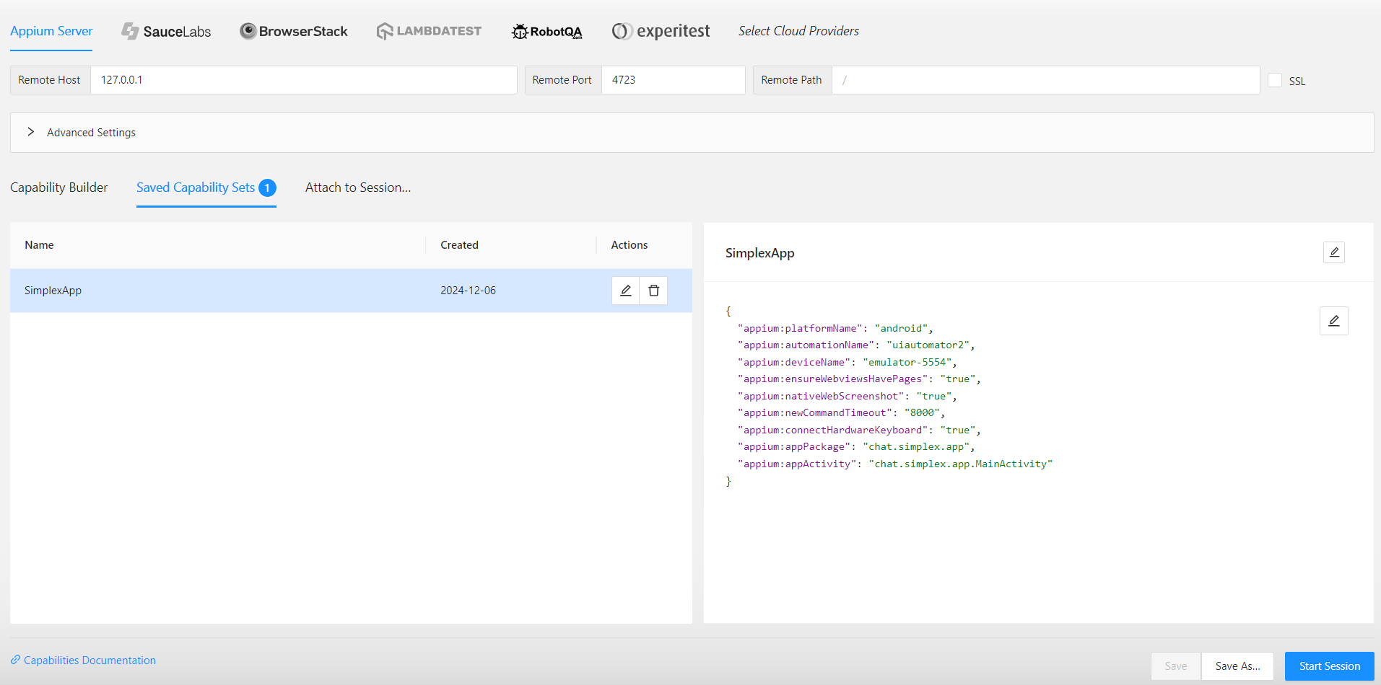
Appium SERVER desirable capabilities

Slide 20
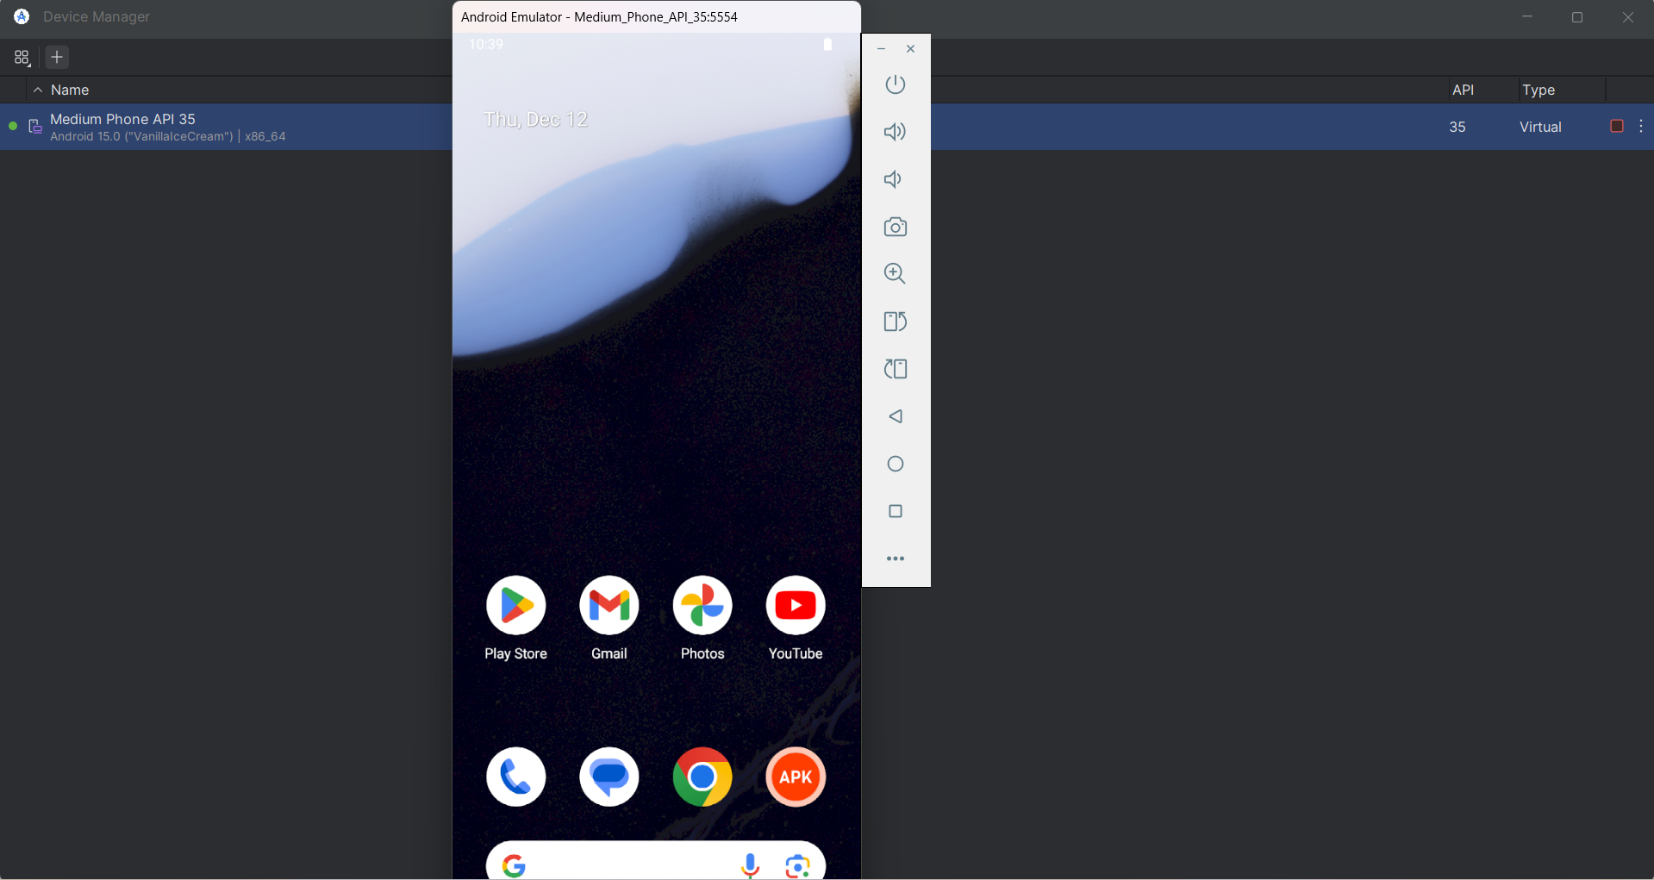
Output in emulator-5554

Slide 21


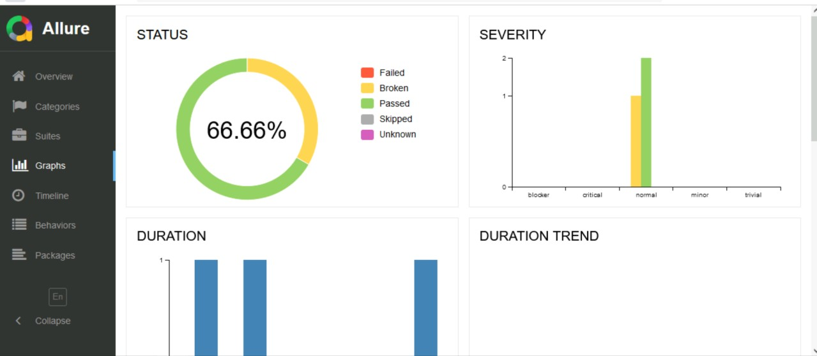
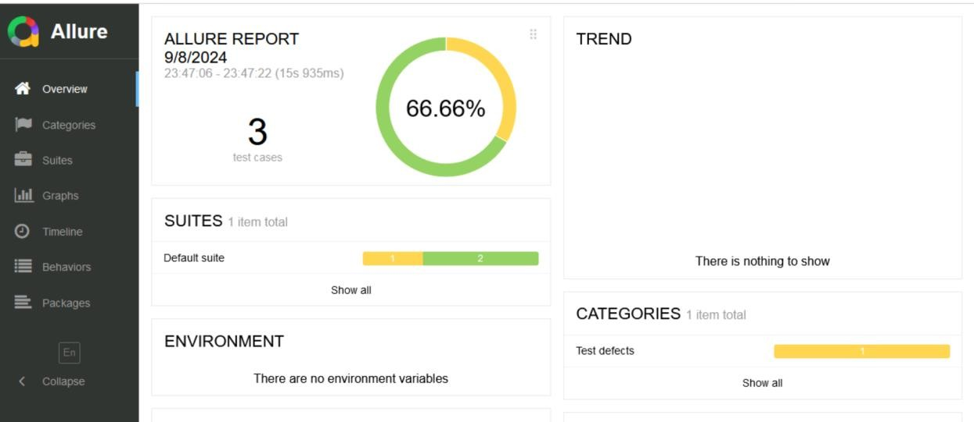
Allure report

Slide 22
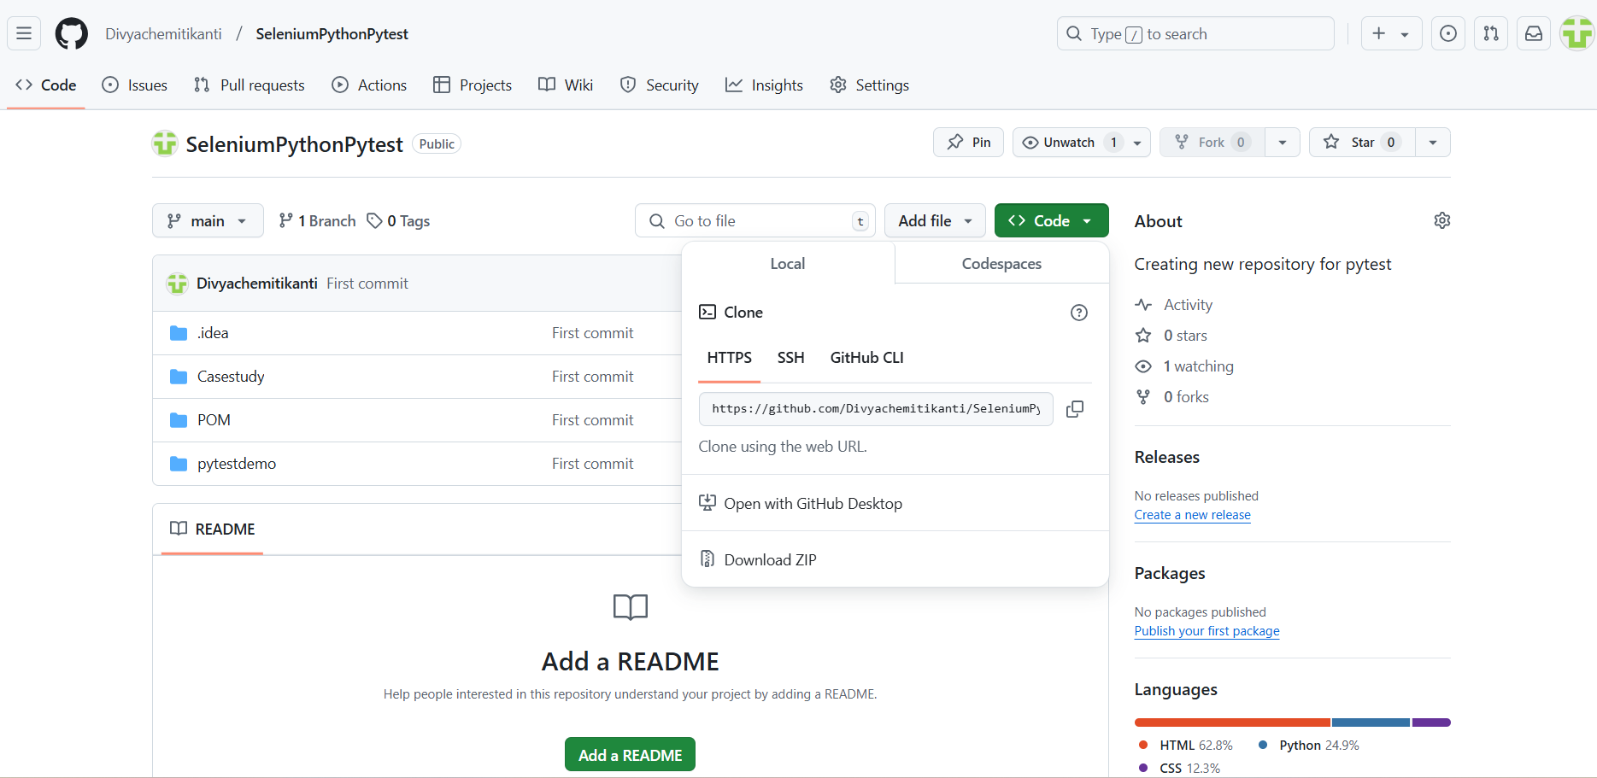
Git Repository Cloning

Slide 23
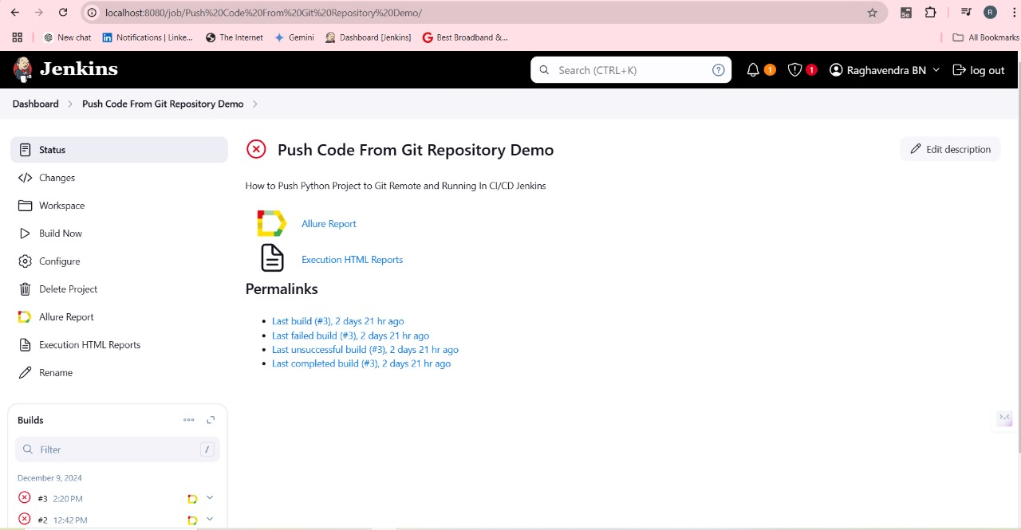
Jenkins

Slide 24

Thank you

